Slide 1
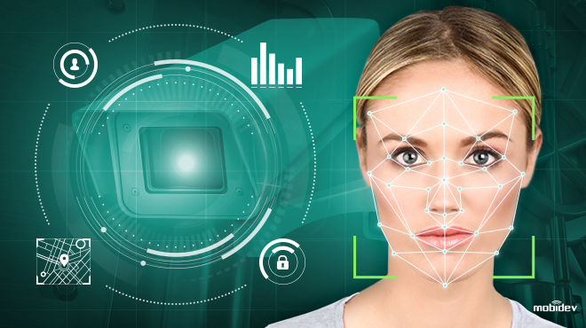
Subject Knowledge on Face recognition, opencv and numpy

Slide 2
Face recognition
A facial recognition system is a technology capable of matching a human face from a digital image or a video frame against a database of faces, typically employed to authenticate users through ID verification services, works by pinpointing and measuring facial features from a given image.
Applications of face recognition:
Security system
Aid forensic investigations
Diagnose diseases
Track school attendance
Secure transactions and etc..

Slide 3
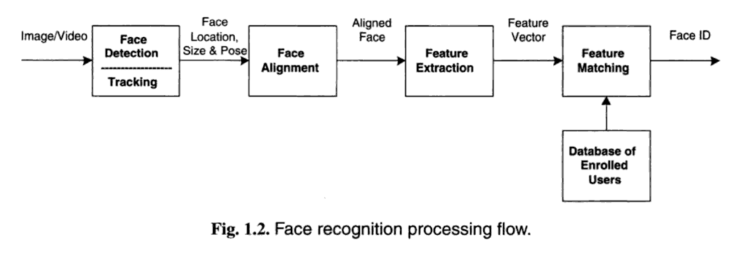
Face recognition

Slide 4
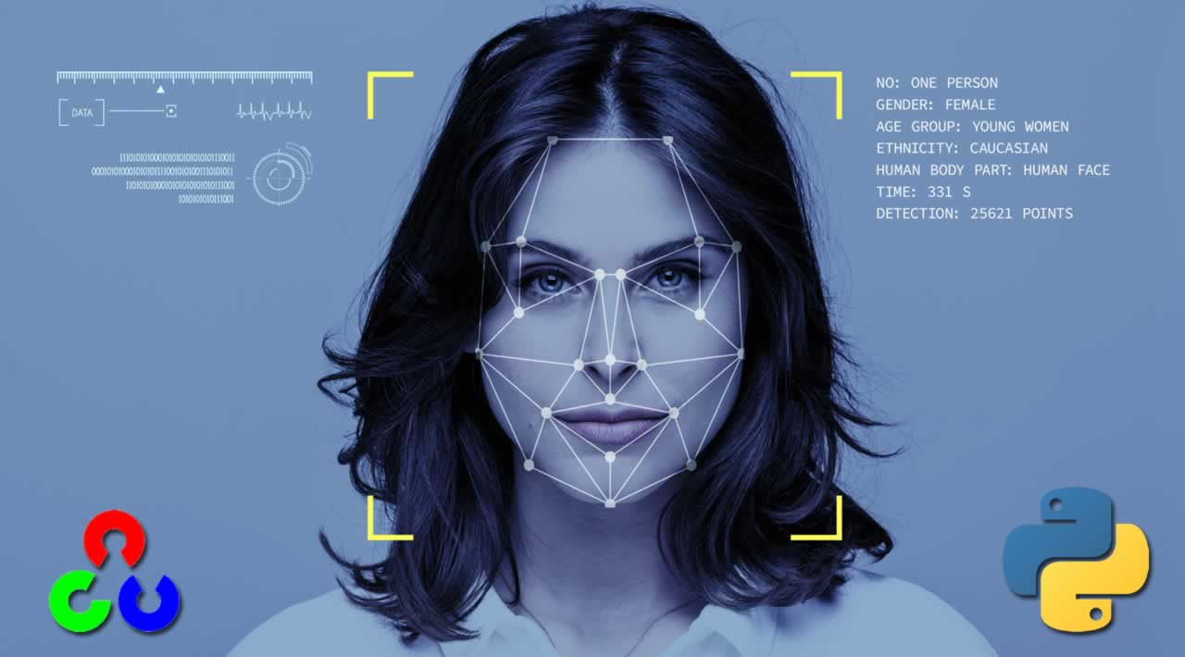
Steps involving in face recognition
Face Detection. Locate one or more faces in the image and mark with a bounding box.
Face Alignment. Normalize the face to be consistent with the database, such as geometry and photometrics.
Feature Extraction. Extract features from the face that can be used for the recognition task.
Face Recognition. Perform matching of
the face against one or more known faces in
a prepared database.

Slide 5
All about Opencv
OpenCV is the most popular library for computer vision. Originally written in C/C++, it now provides bindings for Python.
OpenCV uses machine learning algorithms to search for faces within a picture. Because faces are so complicated, there isn’t one simple test that will tell you if it found a face or not. Instead, there are thousands of small patterns and features that must be matched. The algorithms break the task of identifying the face into thousands of smaller, bite-sized tasks, each of which is easy to solve. These tasks are also called classifiers.
How to install opencv?
Pip install opencv-python

Slide 6

OpenCV Functionality:
Image/video I/O, processing, display (core, imgproc, highgui)
Object/feature detection (objdetect, features2d, nonfree)
Geometry-based monocular or stereo computer vision (calib3d, stitching, videostab)
Computational photography (photo, video, superres)
Machine learning & clustering (ml, flann)
CUDA acceleration (gpu)

Slide 7
All about numpy
NumPy is an open-source numerical Python library.
NumPy contains a multi-dimensional array and matrix data structures.
It can be utilised to perform a number of mathematical operations on arrays such as trigonometric, statistical, and algebraic routines. Therefore, the library contains a large number of mathematical, algebraic, and transformation functions.
NumPy is a wrapper around a library implemented in C.
Pandas objects rely heavily on NumPy objects. Essentially, Pandas extends Numpy.

Slide 8

How to install numpy?
pip install numpy

Slide 9
Thankyou!!
Presented by:
Yukti Singh
19BAI10015

